Slide 1
Recurrent Neural Network

Slide 2
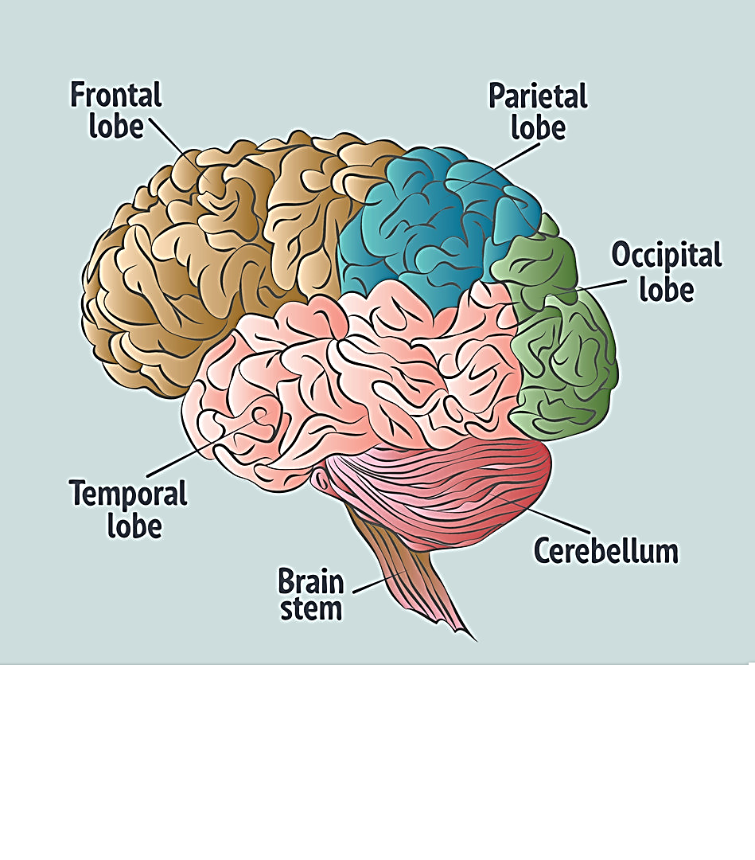

Slide 3
Recurrent Neural Network (RNN)
Recurrent Neural Network is a generalization of feedforward neural network that has an internal memory. RNN is recurrent in nature as it performs the same function for every input of data while the output of the current input depends on the past one computation. After producing the output, it is copied and sent back into the recurrent network. For making a decision, it considers the current input and the output that it has learned from the previous input.
Unlike feedforward neural networks, RNNs can use their internal state (memory) to process sequences of inputs. This makes them applicable to tasks such as unsegmented, connected handwriting recognition or speech recognition. In other neural networks, all the inputs are independent of each other. But in RNN, all the inputs are related to each other.

Slide 4
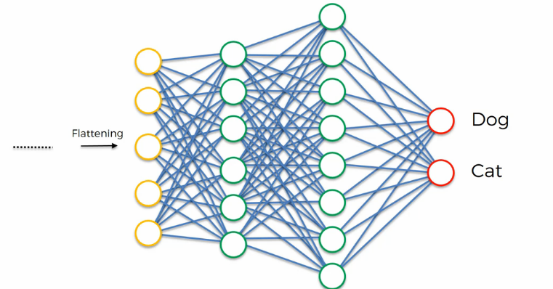
RNN Architecture and Working…

Slide 5
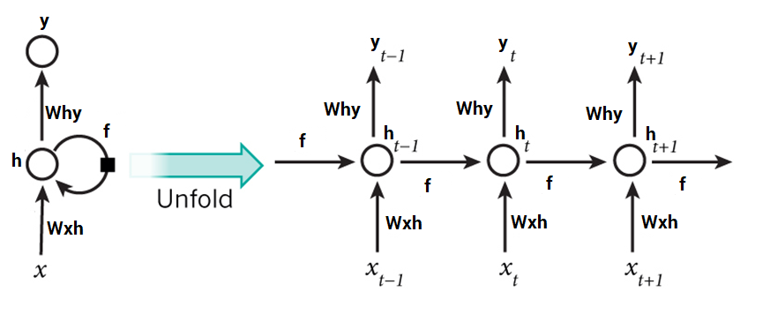
Unfold the RNN Layers

Slide 6
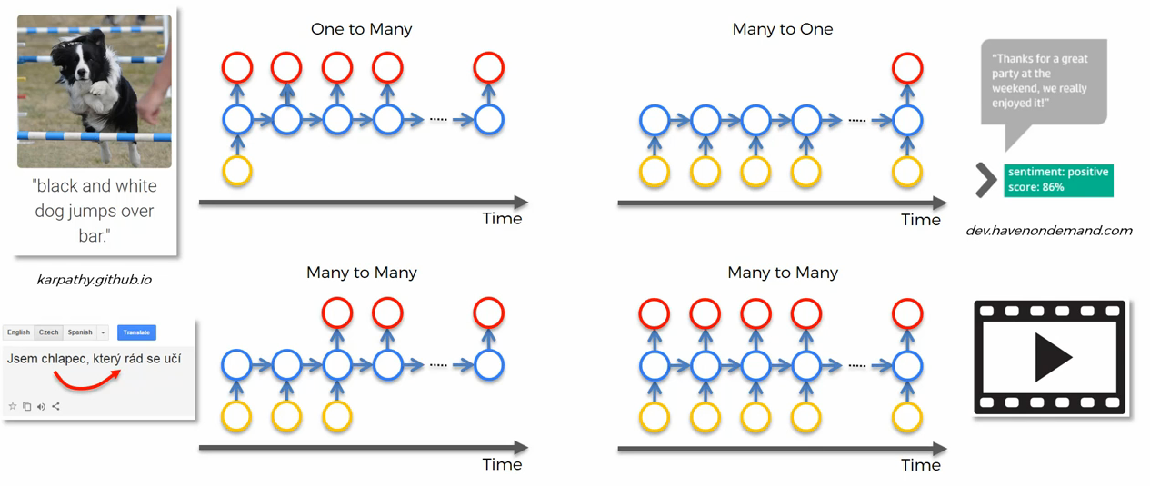
Examples of RNN with respect to the relationships

Slide 7
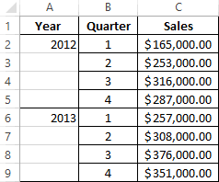
What is Time series Analysis, How relate it is RNN to
A time series is a series of data points indexed in time order. Most commonly, a time series is a sequence taken at successive equally spaced points in time. Thus it is a sequence of discrete-time data
Time series model is purely dependent on the idea that past behavior and price patterns can be used to predict future price behavior.

Slide 8
Vanishing Gradient problem
The vanishing gradient makes the gradient very close to zero, so it's difficult to know where to move in the state space; the exploding gradient makes the gradient a very large value, so it makes learning unstable. This problem is more pronounced in recurrent networks since they use the same matrix at each time step.

Slide 9
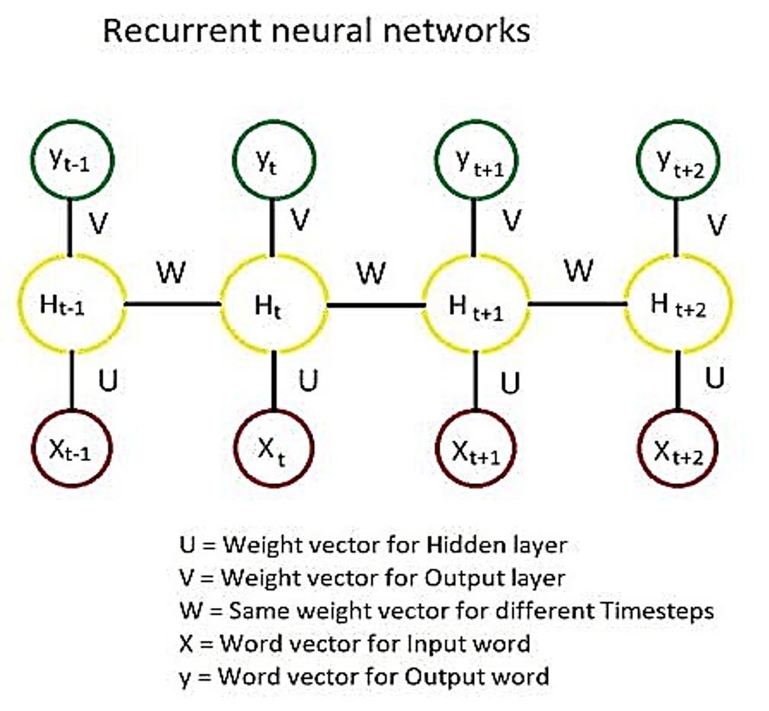
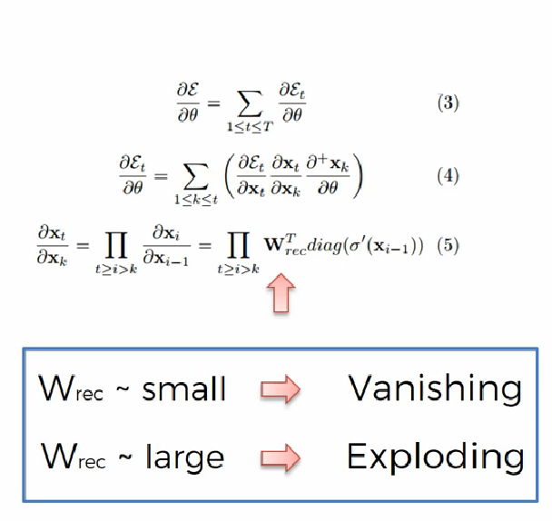

Slide 10
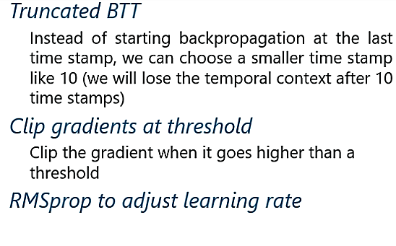
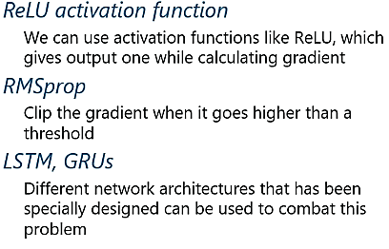
Exploding Gradient:
The working of the exploding gradient is similar but the weights here change drastically instead of negligible change. Notice the small change.
Vanishing Gradient:
When making use of back-propagation the goal is to calculate the error which is actually found out by finding out the difference between the actual output and the model output and raising.

Slide 11
Basic LSTM
Long short-term memory network was first introduced in 1997 by Sepp Hochreiter and his supervisor for a Ph.D. thesis.
LSTM is a special kind of RNN, capable of learning long term dependencies.
Remembering information for long period of time is it’s default behavior.
Long short-term memory (LSTM) network is the most popular solution to the vanishing gradient problem.

Slide 12
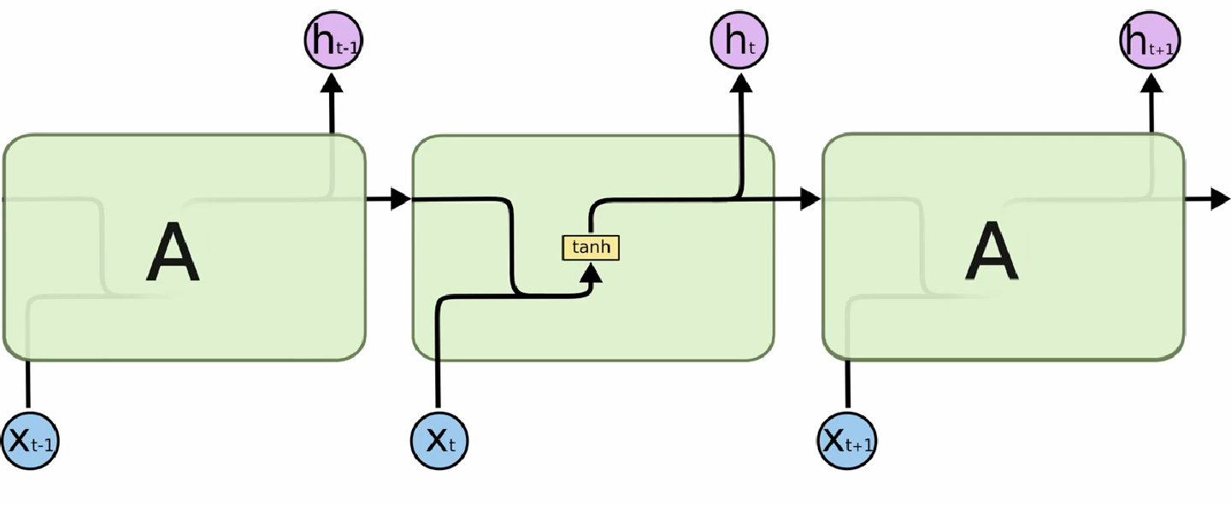
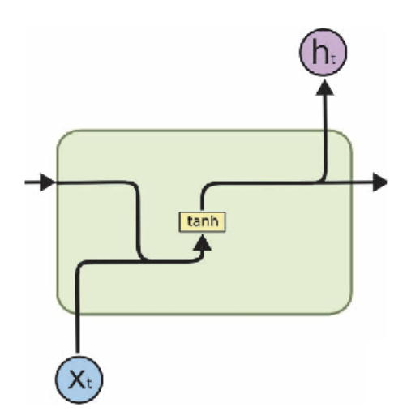

Slide 13
First Understand the RNN Works
This is a cat, and _____ is a good pet animal

Slide 14
Looking More Clearly

Slide 15
Looking More Clearly

Slide 16
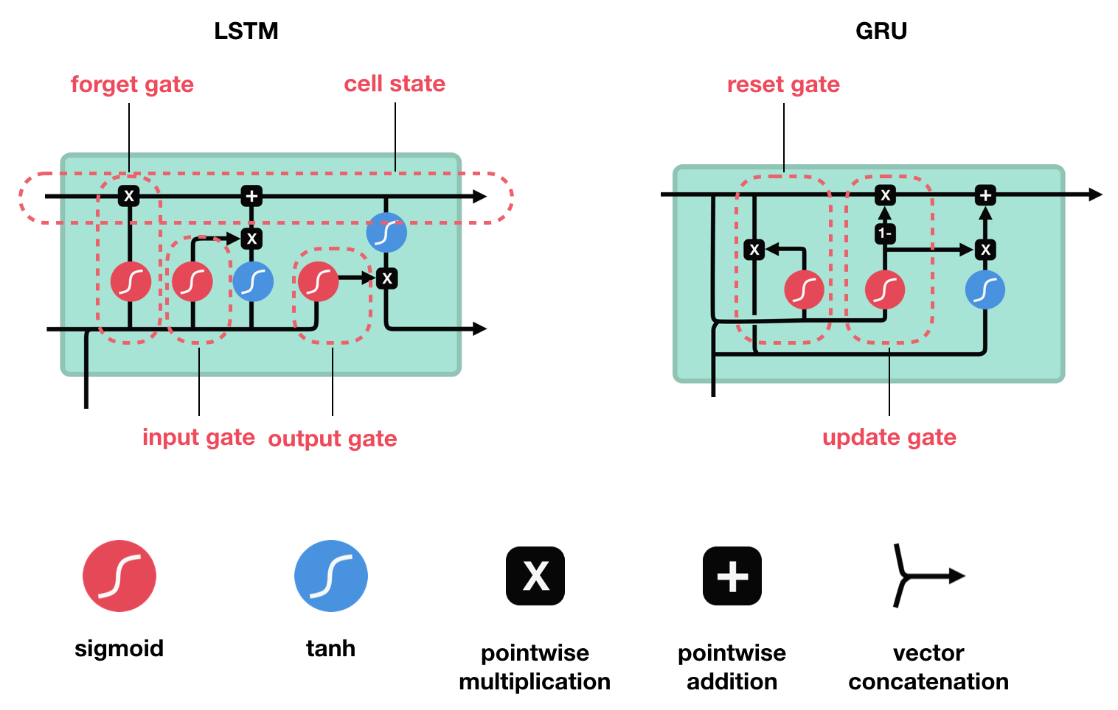
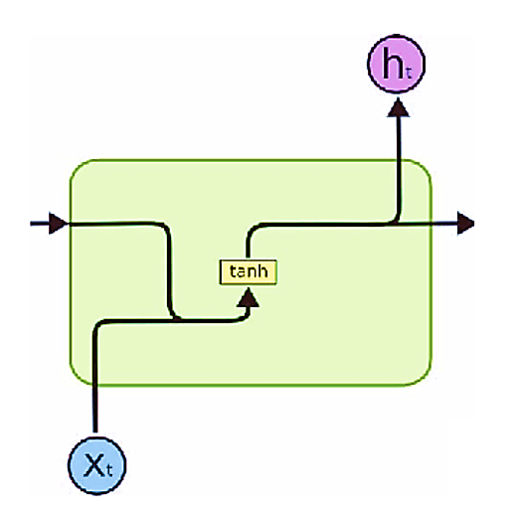
LSTM’s and GRU’s as a solution
LSTM ’s and GRU’s were created as the solution to short-term memory. They have internal mechanisms called gates that can regulate the flow of information.

Slide 17
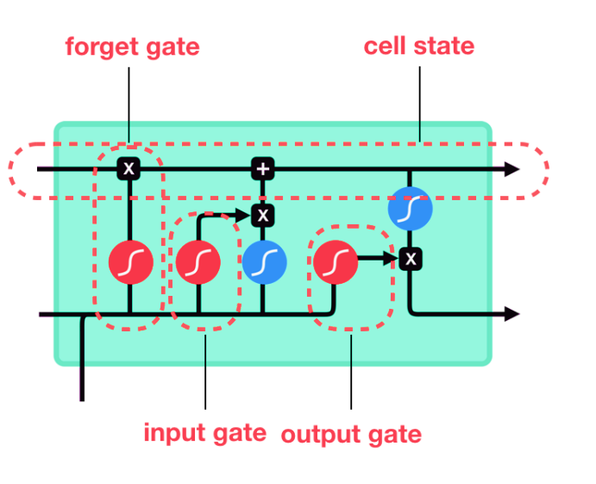
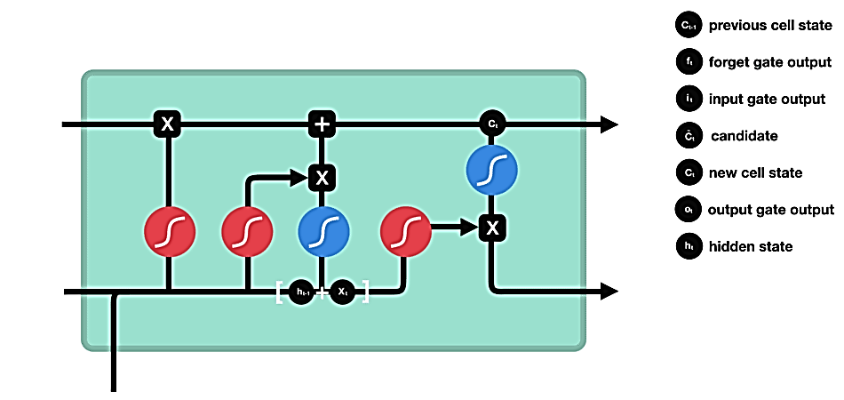
LSTM’s as a solution

Slide 18
LSTM’s as a solution (steps)
First, the previous hidden state and the current input get concatenated. We’ll call it combine.
2. Combine get’s fed into the forget layer. This layer removes non-relevant data.
4. A candidate layer is created using combine. The candidate holds possible values to add to the cell state.
3. Combine also get’s fed into the input layer. This layer decides what data from the candidate should be added to the new cell state.
5. After computing the forget layer, candidate layer, and the input layer, the cell state is calculated using those vectors and the previous cell state.
6. The output is then computed.
7. Pointwise multiplying the output and the new cell state gives us the new hidden state.

Slide 19
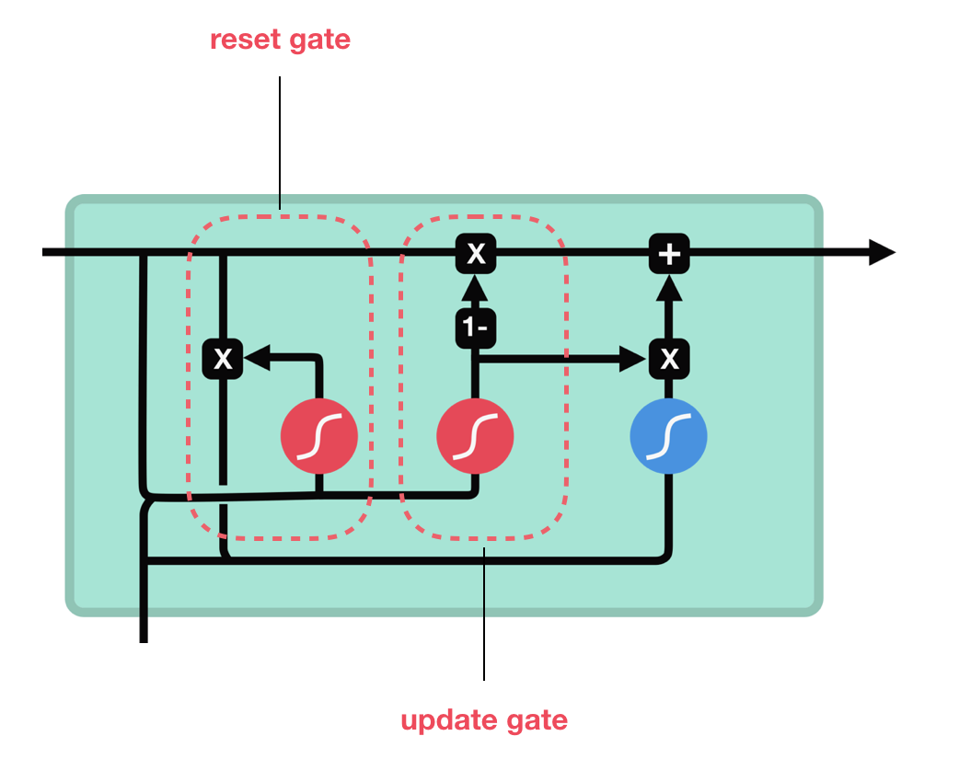
GRU’s () Gated Recurrent Unit, as a solution
Now we know how an LSTM work, let’s briefly look at the GRU. The GRU is the newer generation of Recurrent Neural networks and is pretty similar to an LSTM. GRU’s got rid of the cell state and used the hidden state to transfer information. It also only has two gates, a reset gate and update gate.

Slide 20
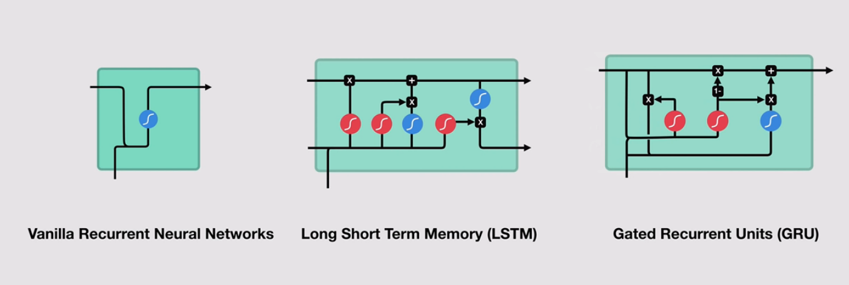
RNN vs LSTM vs GRU

Slide 21
RNN vs LSTM vs GRU
The key difference between a GRU and an LSTM is that a GRU has two gates (reset and update gates) whereas an LSTM has three gates (namely input, output and forget gates).
GRUs train faster and perform better than LSTMs on less training data if you are doing language modeling (not sure about other tasks).
GRUs are simpler and thus easier to modify, for example adding new gates in case of additional input to the network. It's just less code in general.
LSTMs should in theory remember longer sequences than GRUs and outperform them in tasks requiring modeling long-distance relations.

